Slide 1
Team Hope
Project 1
An evaluation of covid data

Slide 2
Objectives
Discuss the data used and how the data were cleaned
Discuss and evaluate our research questions
Discuss overarching findings from data analysis

Slide 3
Project Goals and Research Questions
Goal:
Data mine Covid Act Now data set for regional differences in vaccination and covid rates, and the relationship between vaccination status and infection rates
Research Questions:
Q1: Are there any differences COVID infection and vaccination rates between lower poverty and higher poverty counties?
Q2: Which states have the highest vaccination and infection rates?
Q3: Which counties in the US had the highest/lowest infection and vaccination rates?
Q4: Does vaccination rate predict infection and hospitalization rates?
Q5: Do educational attainment differences within counties predict vaccination and infection rates?

Slide 4
Dataset selection
https://covidtracking.com/data/api/
https://hrs.isr.umich.edu/about
https://www.covidactnow.org/?s=47813529
https://data.ers.usda.gov/reports.aspx?ID=17826

Slide 5
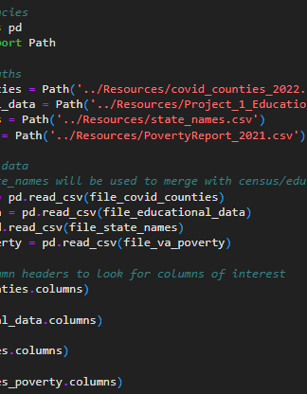


Data Cleaning
Performed manual data review initially to determine the columns of interest.
Imported and assigned each dataset into their own DataFrames in Python.
Renamed columns to make sense of the data.
Determined the Unique Identifiers (UIDs) from each dataset to create a relationship and performed data merge.
Exported the cleaned and merged datasets into Outputs folder.

Slide 6
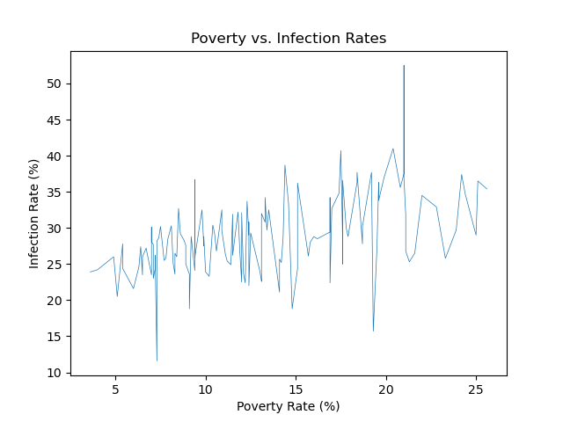
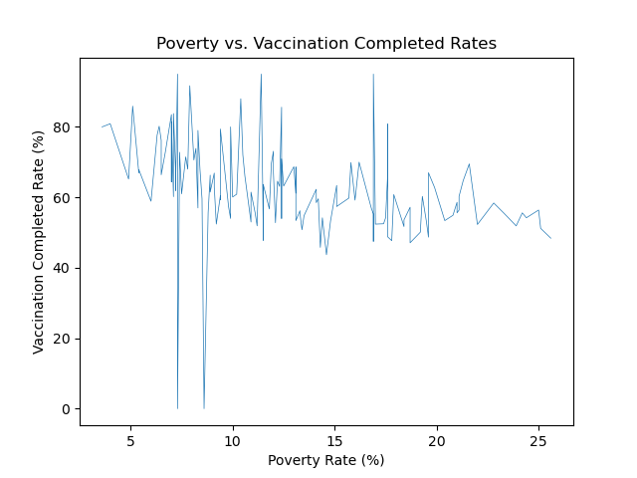
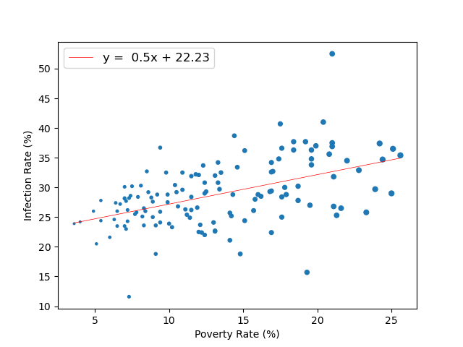
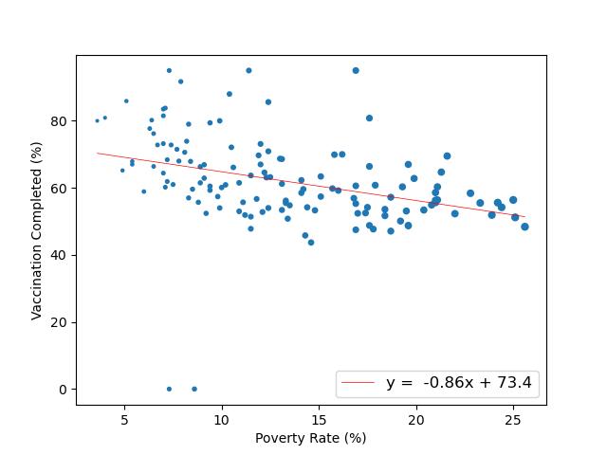
Q1 Are there any differences COVID infection and vaccination rates between lower poverty and higher poverty counties?
Linear regression models showed significant correlation between poverty rate versus vaccination or infection rate.
For poverty rate vs vaccination rate:
R-value = -0.35
P-value = < 0.05
For poverty rate vs infection rate:
R-value = 0.49
P-value = < 0.05
Reasons may be due to lack of medical supplies, facilities (hospital beds/treatment centers), and preventive measurement implementation.
Note: even though poverty data for VA was from 2021, the poverty rate should relatively be the same for 2022.

Slide 7
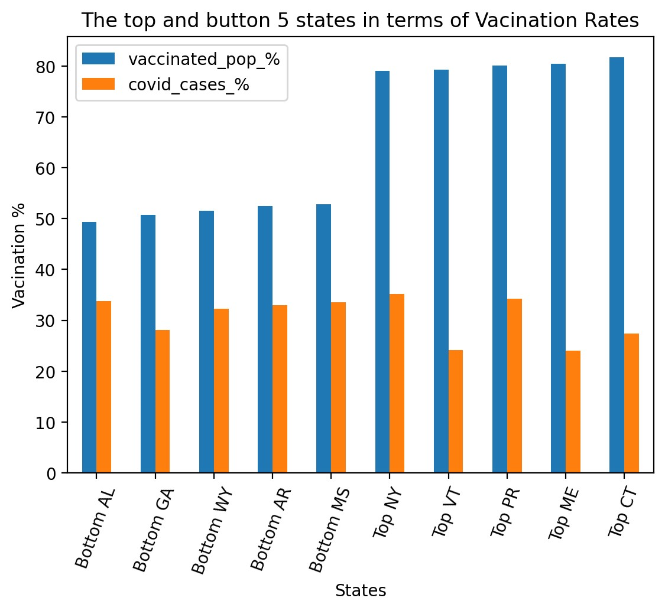
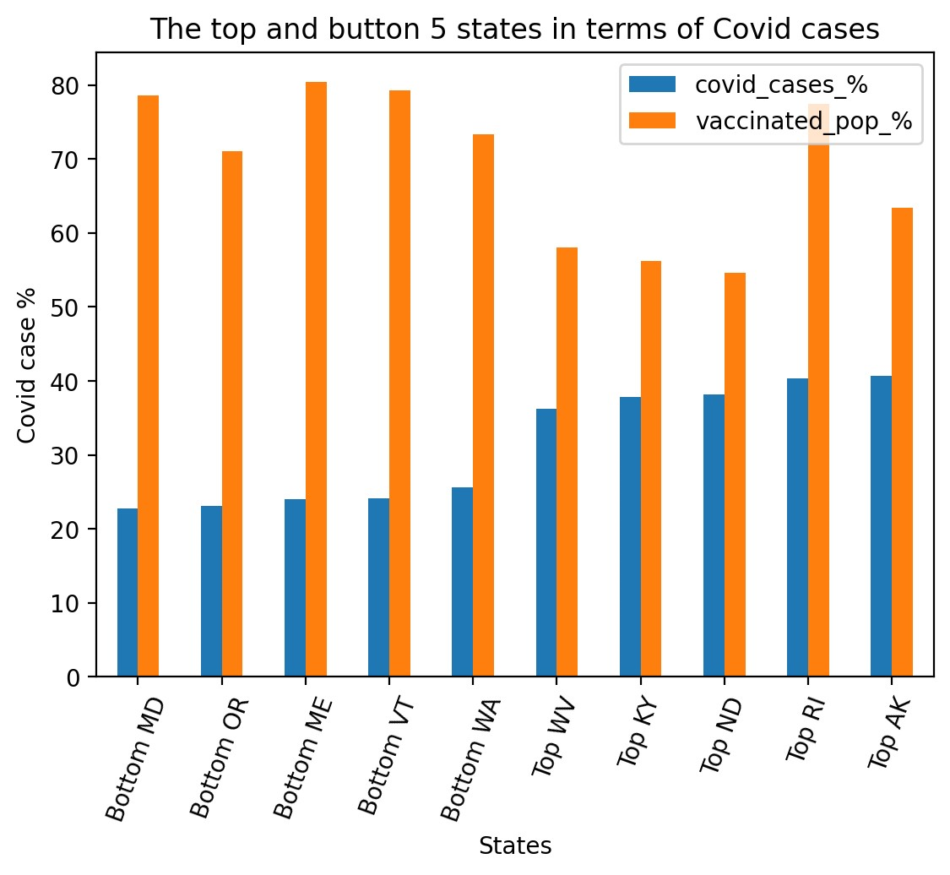
Q2 Which states have the highest vaccination and infection rates?
- The bottom 5 states of vaccination rates are Southern states and 4 of the top 5 states are Northeastern states.
- We cannot draw conclusions from the bar charts.

Slide 8
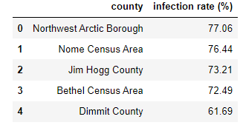
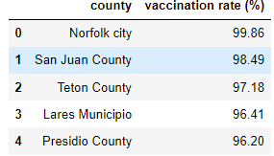
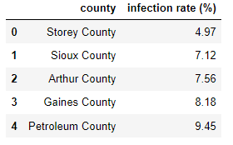
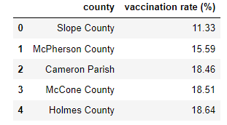
Q3 Which counties in the US had the highest/lowest infection and vaccination rates?
Highest Infection
Lowest Infection
Highest Vaccination
Lowest Vaccination

Slide 9
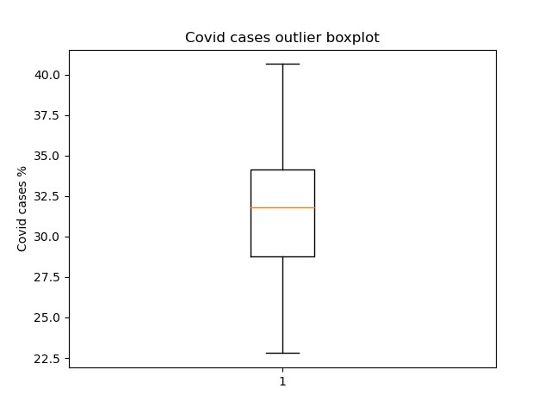
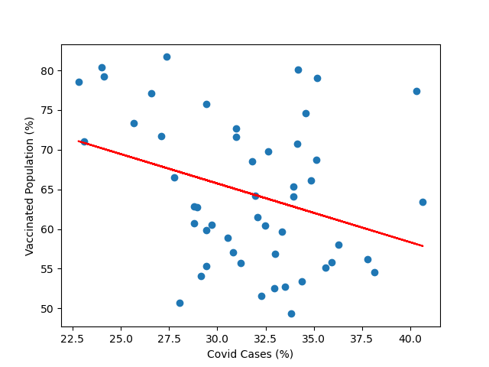
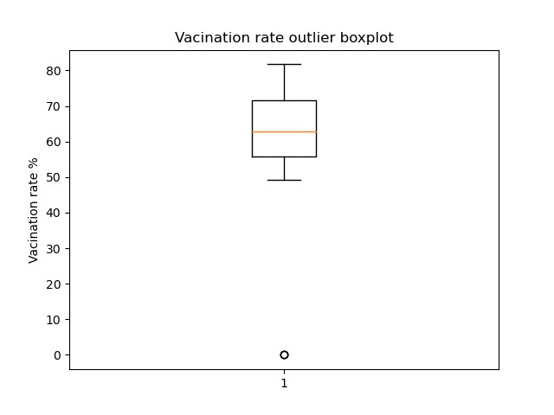
Q4A Does vaccination rate predict infection rates?
- Dataset contained several outliers due to inaccuracy in the dataset we validated this with boxplots. We removed three states to improve data accuracy.
- The r-value was 0.33.
- With a p value of 0.02, results are statistically significant.
- Higher vaccination rates correspond to lower case rates within counties.

Slide 10
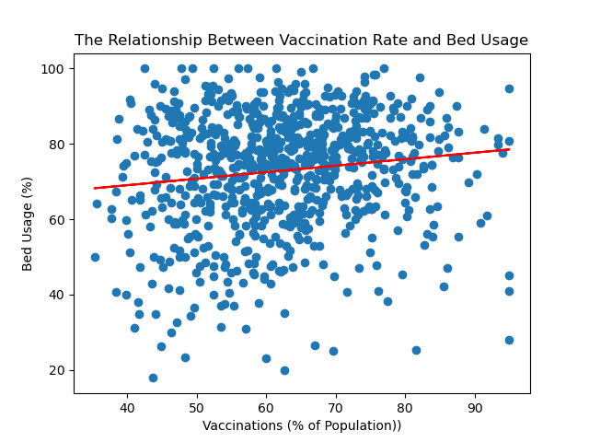
Q4B Does vaccination rate predict hospitalization rates?
R= 0.13, p<0.05
Indicates significant positive relationship between vaccinations and bed usage.
Surprise finding: More vaccinated counties have significantly higher bed usage.
Note: Data on bed usage may not have been accurate.
Low reporting percentage.
Multiple usage percentages showed out of range values.

Slide 11
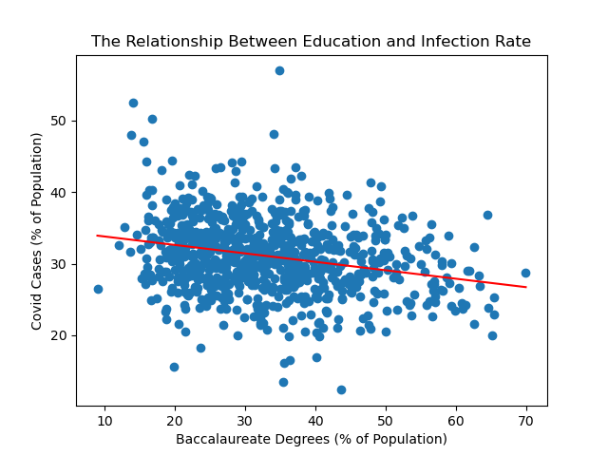
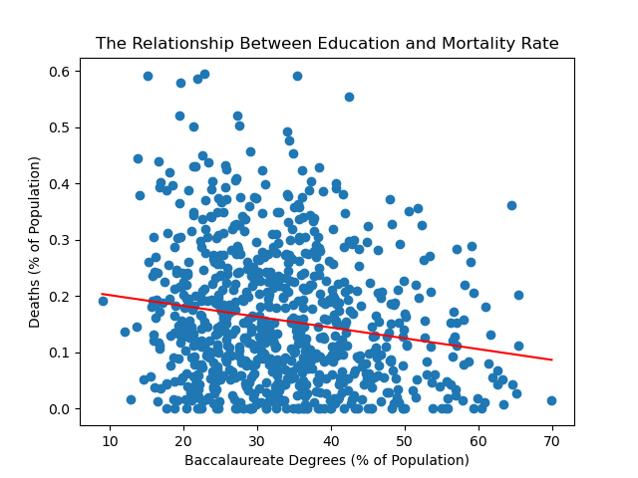
Q5A Do educational attainment differences within counties predict infection rates?
r= -0.25, p<0.05.
Significant negative relationship between education and COVID infection.
Counties with higher percentage of bachelor’s degrees tended to have lower infection rates.
r= -0.17, p<0.05.
Significant negative relationship between education and COVID mortality.
Counties with higher percentage of bachelor’s degrees tended to have lower COVID death rates.

Slide 12
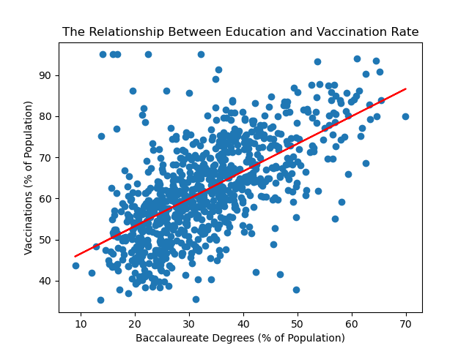
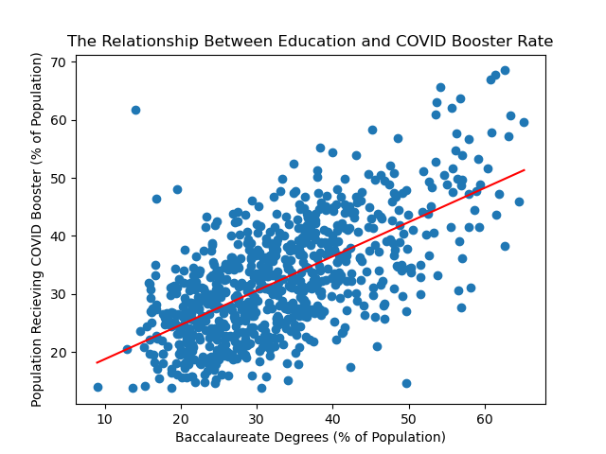
Q5B Do educational attainment differences within counties predict vaccination rates?
r= 0.62, p<0.05.
Significant positive relationship between education and COVID vaccination.
Counties with higher percentage of bachelor’s degrees had higher vaccination rates.
r= 0.64, p<0.05.
Significant positive relationship between education and COVID booster shots.
Counties with higher percentage of bachelor’s degrees had higher COVID booster rates.

Slide 13
Team findings
There appeared to be regional differences in state vaccination rates. However, no regional differences appeared in infection rates.
At the county level, the lowest covid counties were in less populated western counties away from cities. The highest were surprisingly in less populated counties in Alaska and Texas.
Poverty and educational attainment have negative relationships with infection rates and mortality rates.
Poverty and educational attainment have positive relationships with vaccination participation rates.
Educational attainment has a small positive relationship with hospitalization rates.

Slide 14
Team Hope
1st Project in GWU Bootcamp

